Slide 1


Predicting Employee Attrition Using Decision Trees and Random Forests
Maddie Hince

Slide 2
Agenda
01
04
Introduction
Modeling
02
05
Data Understanding
Evaluation
03
06
Data Preparation
Conclusion

Slide 3
Can we predict whether an employee will leave a company based on certain factors?
Employees leave companies everyday (retired, fired, resigned)
Knowing why employees leave can help upper leadership and HR staff of any organization create better hiring and retention strategies
Without employees, you don’t have a company – attrition can affect overall productivity and profit

Slide 4
Data Understanding
Data downloaded from Kaggle, but initially collected as an employee survey by IBM’s HR Department
Raw dataset contains 1470 rows, 35 features (18 used in analysis)
Features used in analysis include hourly pay rate, years since last promotion, and job satisfaction
Relatively small dataset, not much information on details of when or how data was collected

Slide 5
Data Preparation
Use SMOTE to Address Class Imbalance (after baseline model performance evaluation)
Encode Features like Gender, Job Role, and Marital Status
Determine Features to be Used in Analysis

Slide 6
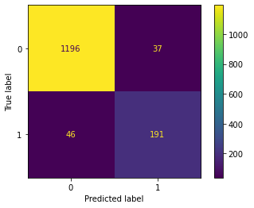
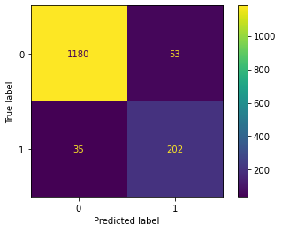
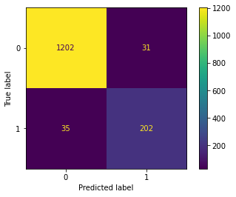
Modeling and Evaluation
Train and Evaluate Baseline Decision Tree Model
Address Class Imbalance with SMOTE
Train and Evaluate Random Forests Model with Resampled Data
Accuracy | 77.45%
Precision | 24.5%
Recall | 20.69%
AUC | 0.5438
Accuracy | 76.09%
Precision | 30.3%
Recall | 39.66%
AUC | 0.6128
Accuracy | 82.07%
Precision | 42.6%
Recall | 39.66%
AUC | 0.6483

Slide 7
Conclusion and Next Steps
Overall good start to solving the employee attrition problem, but will need more rigorous modeling
Resources wasted in case of a false positive
Better data fed into random forests model would most likely result in more accurate predictions
Even after tuning, random forests model did not perform to standard

